Slide 1
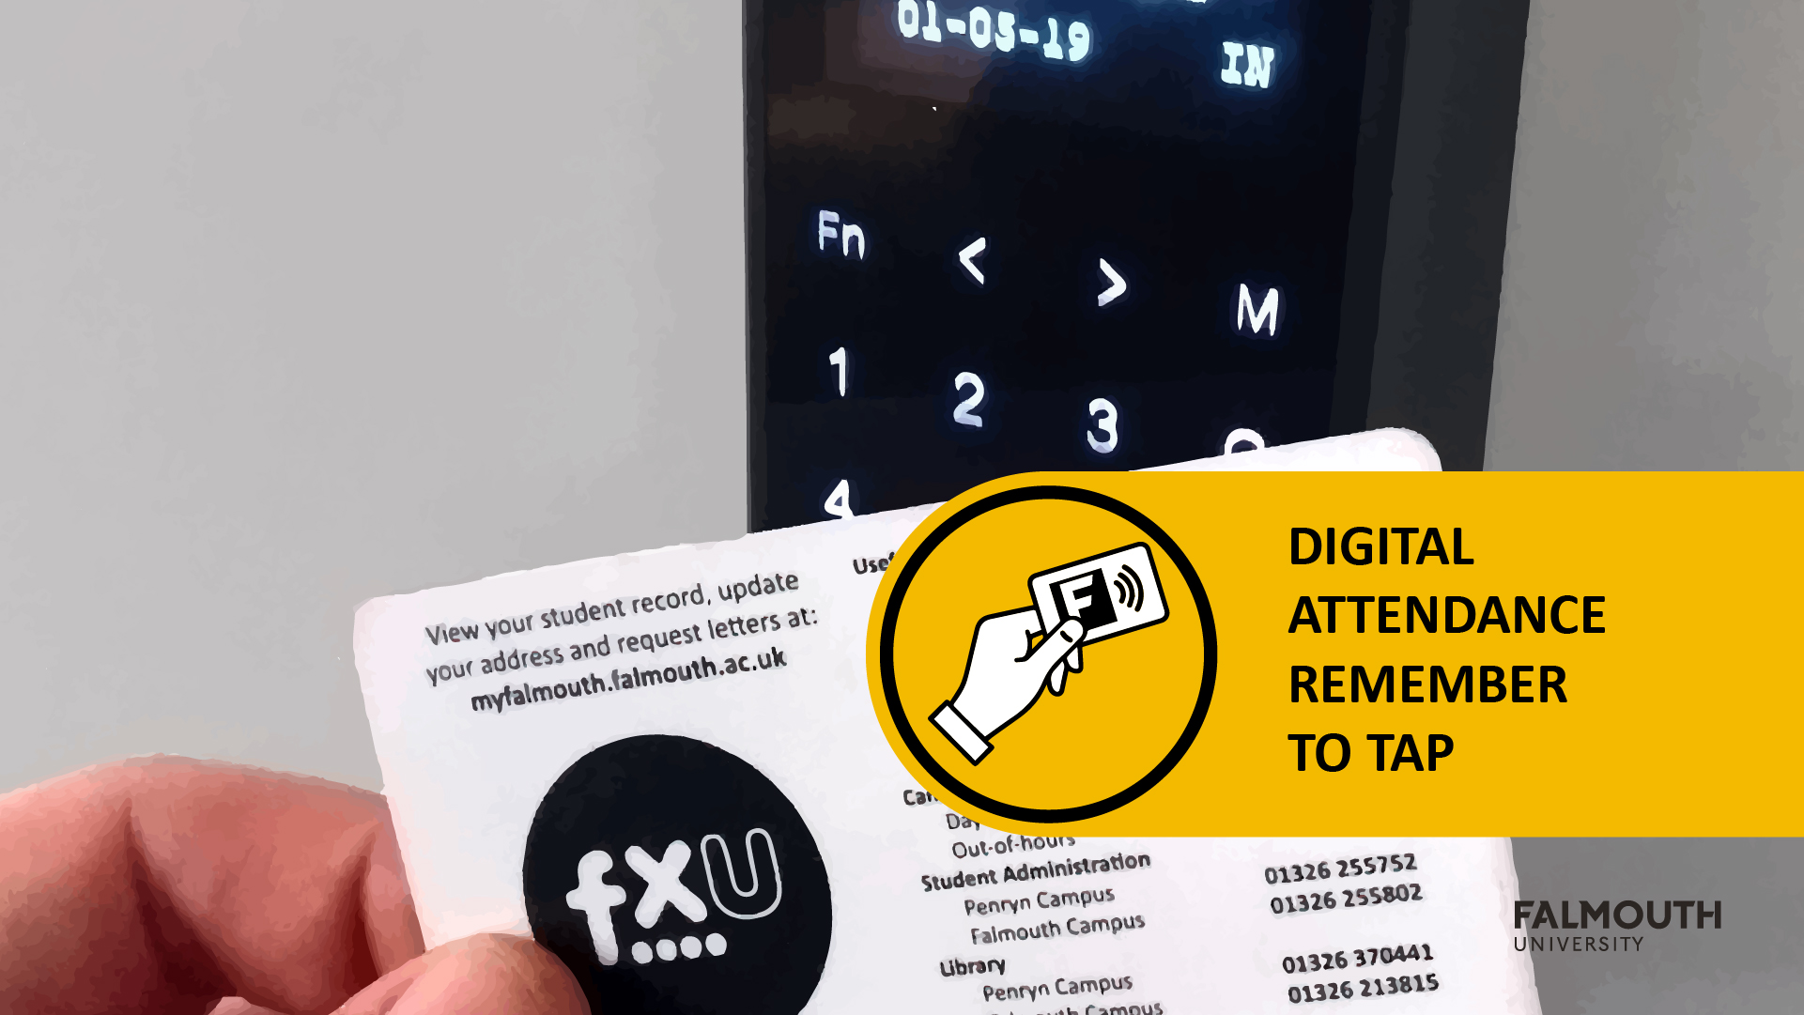

Slide 2


GAM130 –
Moving
Online

Slide 3
Introduction
Since we have now moved to online teaching there are few things we should cover:
Assignment
Expo Replacement
Tips and Techniques to work remotely
First off communication
We are using Microsoft Teams for all teaching online
Download - https://products.office.com/en-gb/microsoft-teams/download-app
We have a Teams Site for you all - https://bit.ly/2UvEhlJ
Students have also setup a Discord - https://discord.gg/4Smtuy

Slide 4
How your teaching is changing?
We will setup up the following sessions
Lecture – Microsoft Teams Live Events
Workshops – Microsoft Teams Meetings
Tutorials –Microsoft Team Meetings or Chats (Private Messaging)
Studio Practice – Staff will be available on Discord and Teams, please ‘@’ and they can setup MS Team Meetings to support
These will align with your timetabled sessions, and you will receive an invite via email ….. PLEASE CHECK YOUR EMAIL
If you don’t receive an invite, please ‘@’ the Tutor on Teams

Slide 5
PLEASE CHECK YOUR EMAIL!!!!

Slide 6
Assignment

Slide 7
Assignment Breakdown
Assignment 1 – Studio Practice
Some changes, mainly expo materials (more on that later)
Assignment 2 – Evaluation
No changes!
No student will be disadvantage for this move to online
All Supervisors have been instructed to take the new situation into account
We will also use our academic judgement to ensure you get the mark you deserve

Slide 8
Assignment 1 – Studio Practice
The assignment mostly stays the same
The Collaborate learning outcome is still be assessed on how you work as a team
Team Working
Version Control
Agile Practice
Reflection
The Deliver learning outcome is still be assessed on the quality of the game
However the Expo Materials have been dropped and replaced with Promo Material

Slide 9
Promo Materials – itch.io page
You must create an itch.io page which contains the following:
Description of the game, with reference to the key features of the game
How to play which includes controls
At least 2 screenshots of your game (considering using GIFs!)
A banner for your game, this should include your game name and team logo
A Game Demo which showcases the game development to date, this should be a downloadable zip file which includes an executable
A Gameplay trailer video, which shows the key gameplay features
Tips on how to create the icth.io page can be found here - https://itch.io/docs/creators/design

Slide 10
Promo Materials – itch.io page
In terms of feel of the page, a really good 1st year page will feel like a very small Indie Game which is charging a few $’s
For good examples, have a look at the following:
https://crowscrowscrows.itch.io/dr-langeskov-the-tiger-and-the-terribly-cursed-emerald-a-whirlwind-heist
https://davidoreilly.itch.io/everything
https://laundrybear.itch.io/morticians-tale
https://finji.itch.io/night-in-the-woods

Slide 11
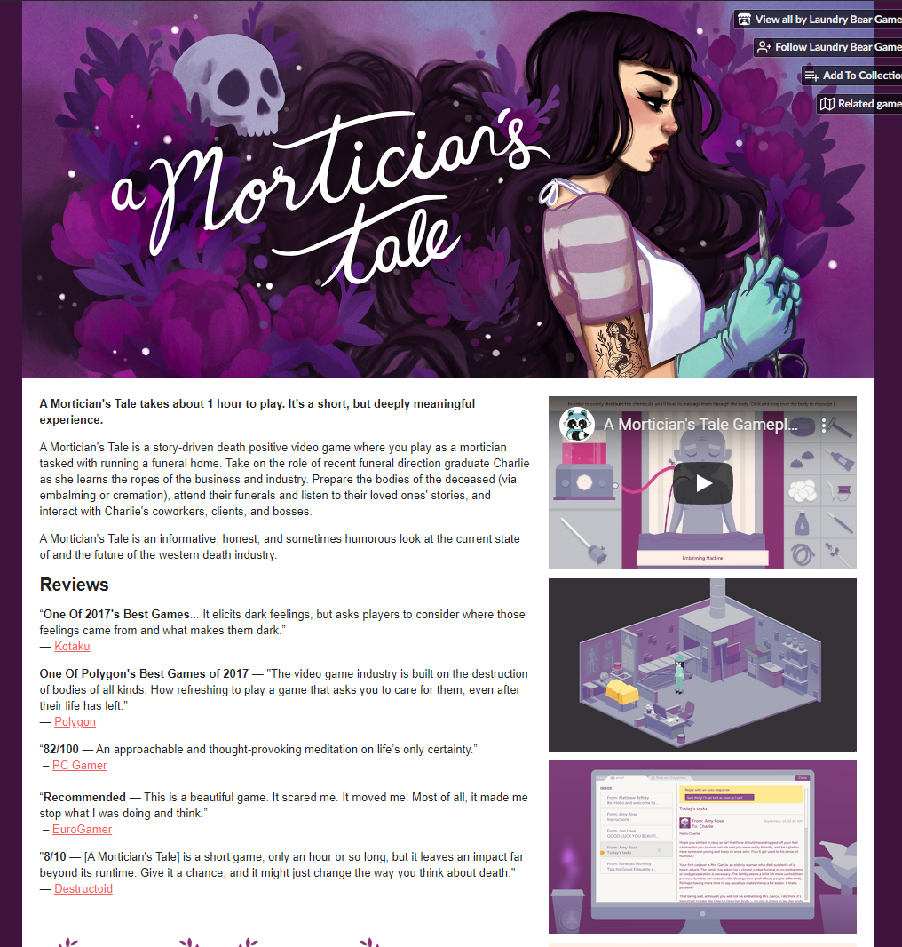

Slide 12
Promo Materials – Trailer
This should show the gameplay of your game
The format is up to you:
Flashy E3 style trailer
‘Lets’ play style
Traditional gameplay trailer
These will be embedded into your itch.io page, this should showcase for your game!

Slide 13
Promo Materials – Brochure Page/Standee
These small stands will be used to explain your game and the controls
This is a summary of what is on your itch.io page
The standee should also feature the game controls, please consider making this easy to read and not just a block of text
Please provide a QR which points to an itch.io page
We will provide a PSD template for this, this will be on the Learning Space
All the brochure pages will be collated for the whole Games Academy

Slide 14
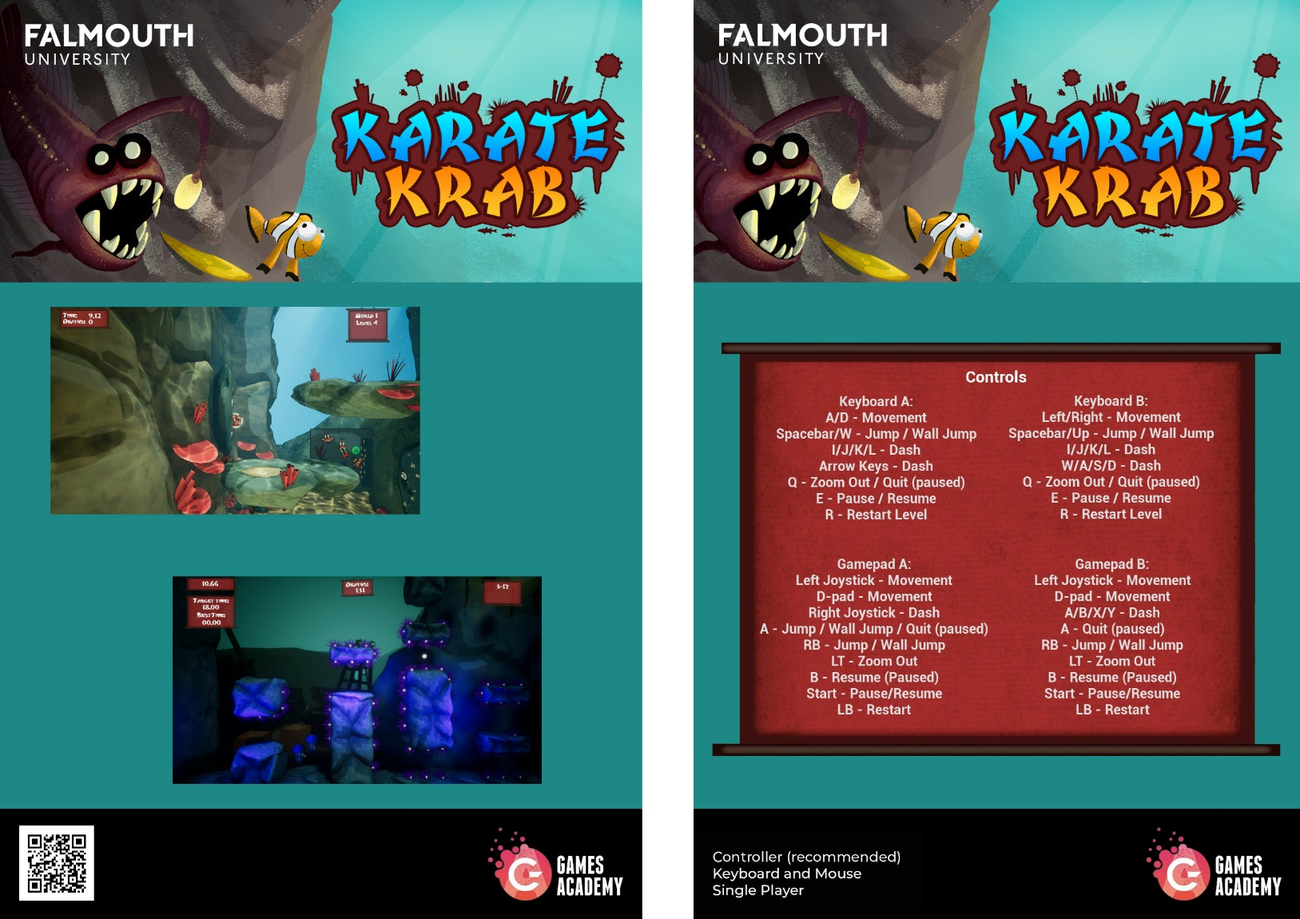
Promo Materials – Game Standees

Slide 15
Promo Materials – Game Standees

Slide 16
Promo Materials – Game Standees

Slide 17
Online Working Tips

Slide 18
As an Individual

Slide 19
Schedules

Slide 20
Tasks

Slide 21
Time Management

Slide 22
Exercise

Slide 23
Cut Distractions

Slide 24
Rest

Slide 25
As a Group

Slide 26
Group Working
Communication is key, make sure meet on Slack/Discord/Teams regularly
Move all stand-ups online …. and actual do them!
Find time to work online together
Use Studio Practice Time
Look at each others timetable and schedule a slot
Be on Slack or Discord at these times
Use Version Control!!
For all other files, setup a shared OneDrive Space
Have an online task board on Trello

Slide 27
Useful Links
Expert Advice: A Guide to Working Remotely in Games- https://gamasutra.com/blogs/DavidLogan/20200319/359737/Expert_Advice_A_Guide_to_Working_Remotely_in_Games.php
Spry Fox: Remote Working - https://www.youtube.com/watch?v=3gbSILzo8hc
The Pomodoro Technique - https://lifehacker.com/productivity-101-a-primer-to-the-pomodoro-technique-1598992730

Slide 28
Questions?

